Slide 1





BLOOM LEVEL SETTING
By:-
Team Titans(CSE O)
Geeta AP23110010698
Revanth AP23110010701
Raghav AP23110010702
Sanjana AP23110010699
Lahari AP23110011034
Vashist AP23110011055

Slide 2

Table of Contents
INTRODUCTION
ARCHITECT DIAGRAM
MODULE DESCRIPTION
BLOOM LEVEL SETTINGS:FIELD DETAILS/PROGRAMMING DETAILS
BLOOM LEVEL SORTING
SORTING ALGORITHMS.
COMPARISON OF SORTING ALGORITHMS
COMPLEXITY OF SORTING ALGORITHMS
BLOOM LEVEL SEARCHING
SEARCHING ALGORITHMS.
COMPARISON OF SEARCHING ALGORITHMS
COMPLEXITY OF SEARCHING ALGORITHMS
SAMPLE SOURCE CODE
OUTPUT
CONCLUSION

Slide 3
Introduction
This project is designed to manage bloom level data, providing a straightforward system for storing, viewing, updating, and deleting bloom records. Bloom data, which includes attributes like `bloom code`, `bloom level`, and descriptions, can be essential for applications needing structured, accessible records. The system ensures that users can efficiently handle this information by offering functions to add new records, modify existing ones, and remove outdated data.
To keep data organized and improve performance, this project uses sorting and searching algorithms. Sorting options include Quick Sort, known for its efficiency with unsorted data, and Merge Sort, valued for its consistent performance and stability. For searching, both Binary Search (for fast lookups on sorted data) and Linear Search (for flexible searches on any data) are implemented. By combining these features, the project not only maintains data integrity but also provides users with multiple tools for accessing and managing bloom data effectively.

Slide 4
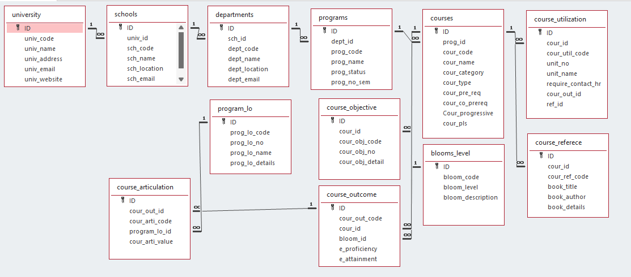

Architecture Diagram

Slide 5
Module Description
This C program module is designed for managing "blooms," which are university data entries that include an ID, `bloom_code`, `bloom_level`, `bloom_des`. The data is stored in a text file (`bloom_setting.txt`) to maintain consistency across sessions, with blooms loaded into memory on startup and saved back to the file after any addition, deletion, or update. Users can perform CRUD operations, allowing them to create, retrieve, update, and delete blooms through a command-line interface. Each action updates the text file, providing reliable data storage.
For data manipulation, the module includes sorting and searching functionalities to organize and locate entries efficiently. Additionally, the program displays the time complexities of the algorithms, helping users understand the efficiency of each operation.

Slide 6
Bloom Level Setting: Field Details
Field Name | Data type
id | integer
bloom_code | String
bloom_level | String
bloom_des | String

Slide 7

Bloom Level Setting : Programming Details
File name:yourregno_module_name
Function/method name
Create:void titans_bloom_create();
Update:void titans_bloom_update();
Retrieve:void titans_bloom_retrieve();
Delete:yvoid titans_bloom_delete();
Sorting:void titans_quick_sort(int low, int high);
Searching:int titans_linear_search(int id);
int titans_compare_search_binarysearch(int id);
void titans_bloom_search();

Slide 8
Bloom Level Setting : Programming Details
Comparison(both searching and Sorting):
Searching int titans_compare_search_binarysearch(int id);
Sorting void titans_compare_sort_mergesort(int left, int right);
Time Complexity:
Searching-void titans_complexity_searching();
Sorting-void titans_complexity_sorting();

Slide 9
Bloom Level: Sorting Algorithm Used
QUICK SORT
QuickSort(arr[], low, high)
if low < high
pivot = Partition(arr[], low, high)
QuickSort(arr[], low, pivot - 1)
QuickSort(arr[], pivot + 1, high)
Partition(arr[], low, high)
pivot = arr[high]
i = low - 1
for j = low to high - 1
if arr[j] is less than pivot based on the sorting criteria
swap arr[i] with arr[j]
i++
swap arr[i + 1] with arr[high]
return i + 1
MERGE SORT
MergeSort(arr[], left, right)
if left < right
mid = (left + right) / 2
MergeSort(arr[], left, mid)
MergeSort(arr[], mid + 1, right)
Merge(arr[], left, mid, right)
Merge(arr[], left, mid, right)
create left_subarray, right_subarray
copy elements to left_subarray and right_subarray
merge the two subarrays back into arr[] based on the sorting criteria

Slide 10

Bloom Level: Comparison of Sorting Algorithm
Quick Sort
Time Complexity: Average case \(O(n \log n)\); worst case \(O(n^2)\) if the data is already sorted or highly unbalanced when using the last element as a pivot.
Stability: Not a stable sort; may reorder elements with equal keys.
Performance: Fast on average, especially for large, randomized data.
Use Case: Preferred when memory is limited and average case efficiency is prioritized.
-Algorithm: Divides data using a pivot element and recursively sorts each partition.
Merge Sort
Data Requirement: Requires extra memory for temporary arrays but provides stable sorting.
Time Complexity: Consistently \(O(n \log n)\) for all cases, making it reliable.
Stability: Stable sort; maintains order of elements with equal keys.
Performance: Consistent performance across all datasets, ideal for large or pre-sorted data.
Use Case: Ideal when consistent performance and stability are needed, even for sorted or partially sorted data.
Algorithm: Divides data into halves, recursively sorts, and merges them in order.

Slide 11

Bloom Level: Time Complexity Of Sorting
Algorithm
Quick Sort:
Best Case: O(n log n) (when the pivot divides the array into two equal parts)
Average Case: O(n log n)
Worst Case: O(n^2) (when the pivot is always the smallest or largest element)
Merge Sort:
Best Case:O(n log n)
Average Case: O(n log n)
Worst Case: O(n log n) (merge sort always divides the array in half and merges, regardless of the order of elements)
Merge Sort has a consistent time complexity of O(n log n), making it reliable for larger datasets or when stability is required.

Slide 12
Bloom Level: Searching Algorithm Used
LINEAR SEARCH
LinearSearch(arr[], target_code, target_name, target_email)
for each element in arr[]
if element's code == target_code
and element's name == target_name
and element's email == target_email
return index
return -1
BINARY SEARCH
BinarySearch(arr[], target_code, target_name, target_email)
left = 0
right = arr.length - 1
while left <= right
mid = (left + right) / 2
if arr[mid] matches target based on code, name, and email
return mid
else if arr[mid] is less than target based on sorting criteria
left = mid + 1
else
right = mid - 1
return -1

Slide 13

Bloom Level: Comparison Of Searching Algorithm
Binary Search
Data Requirement Requires blooms to be sorted by `bloom code`, `bloom name`, or other relevant fields before searching.
Time Complexity:O(log n), making it efficient for larger datasets.
Performance: Faster for large, sorted datasets due to logarithmic complexity.
Use Case: Suitable for quickly finding a specific `bloom code` or other sorted fields in large datasets.
Algorithm Divides the search space in half with each step (binary approach).
Linear Search
Data Requirement: Works on unsorted data, no pre-sorting needed.
Time Complexity: (O(n), as each entry is checked sequentially.
Performance: Slower for large datasets, especially if not sorted.
Use Case: Practical for small or unsorted datasets.
Algorithm: Checks each bloom entry one-by-one.

Slide 14
Bloom Level: Time Complexity of Searching Algorithm
Linear Search:
Best Case: O(1) (if the target is the first element)
Average/Worst Case: O(n) (goes through all elements if needed)
Binary Search:
Best Case: O(1) (if the target is the middle element)
Average/Worst Case: O(logn) (efficient due to halving the search space)
Binary search is more quicker and efficient to use compared to linear search as its time complexity is half of linear search technique.

Slide 15

Source Code

Slide 16
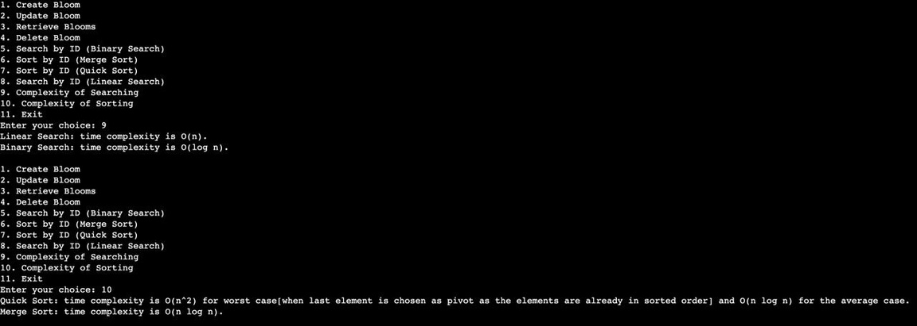
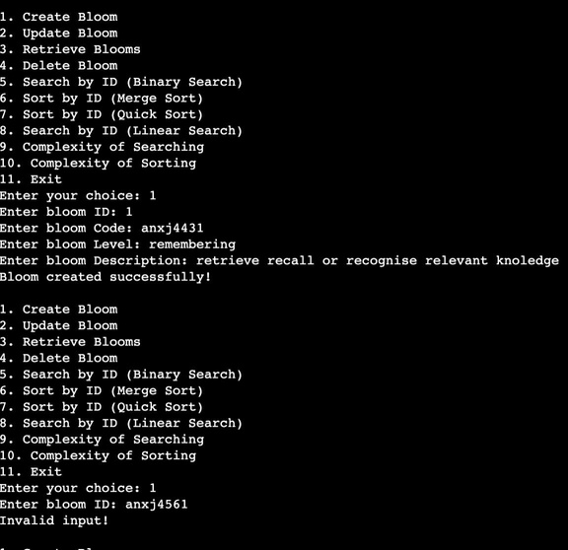
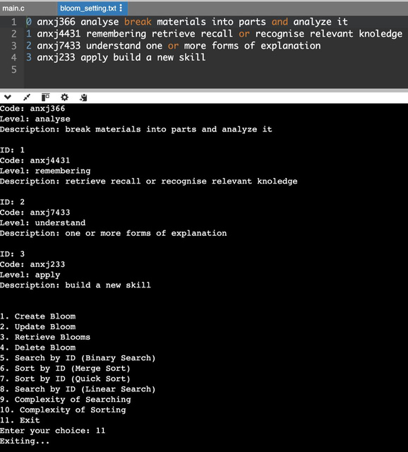
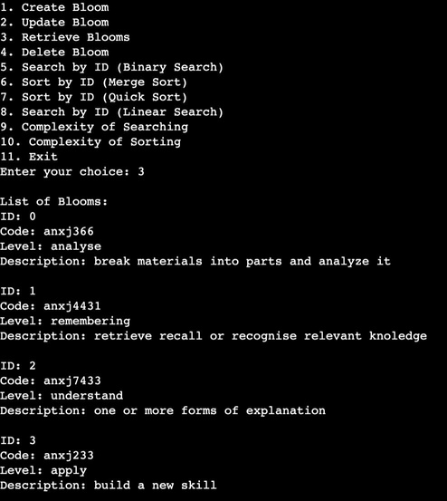
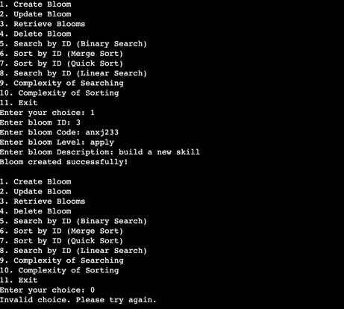
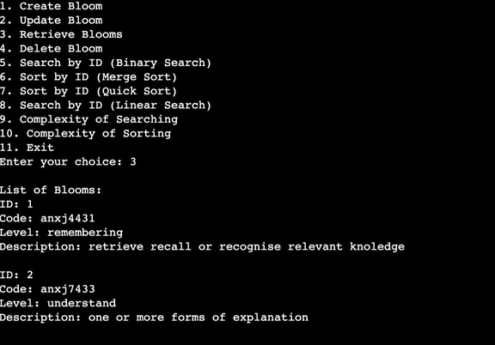
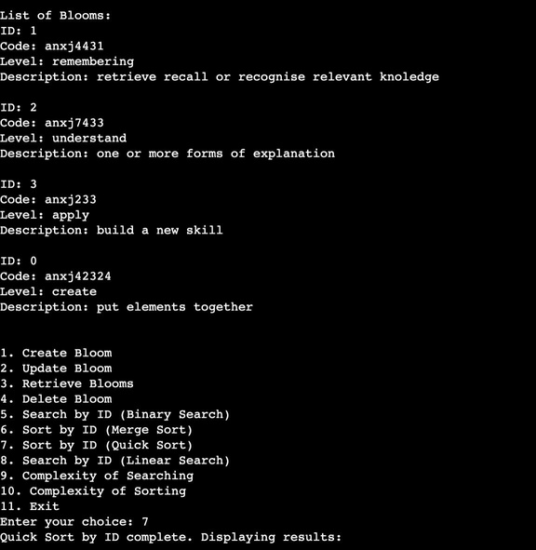
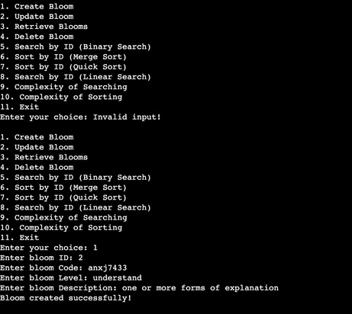
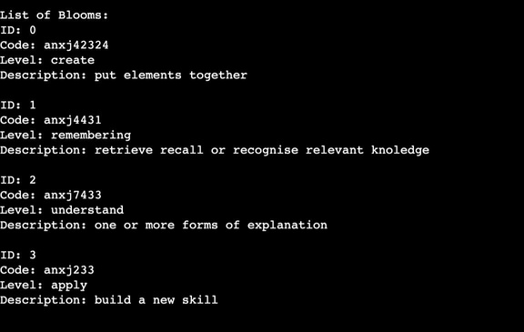
OUTPUT

Slide 17

Conclusion
This project creates a simple and effective system to manage bloom level data, allowing users to store, view, update, and delete information as needed. To keep data organized and easy to find, the program includes sorting and searching methods. Merge Sort is used for its steady and reliable performance, while Quick Sort provides faster sorting for unsorted data. For searching, Binary Search is used for quick lookups on sorted data, and Linear Search allows for flexible searches on unsorted data.
Overall, the project efficiently handles data operations and keeps information saved in a file, making sure that changes are kept even after the program closes. This project demonstrates basic principles of data management, showing how to choose and use different algorithms based on specific needs to create a reliable system for managing bloom level data.

Slide 18
THANK
YOU

